Slide 1

Lesson: Following the Group Plan
Skill # Standard SEL4: The child will demonstrate impulse control and stress management.
TELL:
Today we are going to listen to story about a duck named Daisy. She had a hard time listening to her Momma and following the group plan.
Click on the title to listen to the story.
Come Along, Daisy!

Slide 2
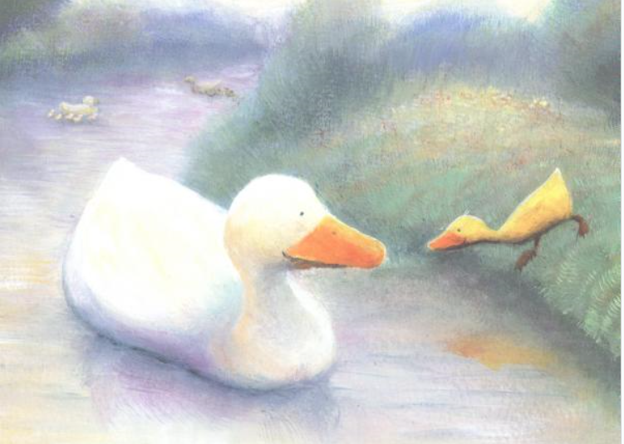
Lesson: Following the Group Plan
Skill # Standard SEL4: The child will demonstrate impulse control and stress management.
TELL:
The group plan for Daisy was to stay close to her Momma but Daisy didn’t do that.
She followed her own plan and watched the fish.
What happened to Daisy when she didn’t follow the group plan?

Slide 3
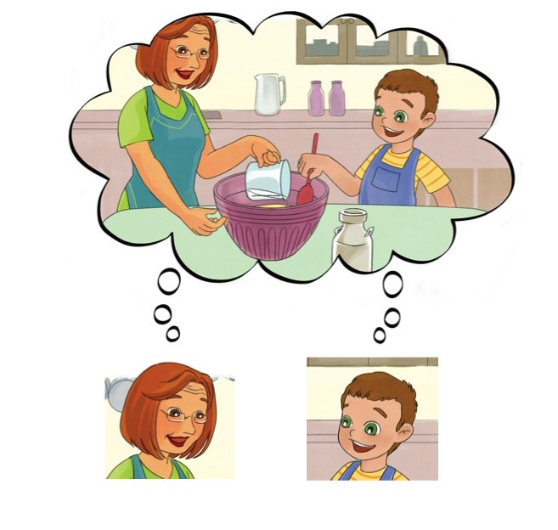
Lesson: Following the Group Plan
Skill # Standard SEL4: The child will demonstrate impulse control and stress management.
TELL:
Focus words: Group Plan
When everyone is thinking and doing the same thing it is called the group plan.
The group plan is also doing what is expected of you at that moment.

Slide 4
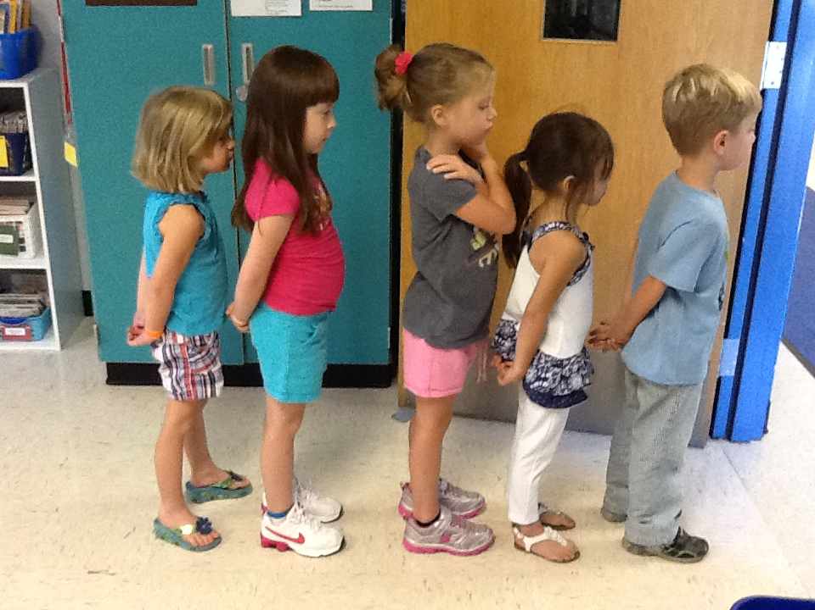
Lesson: Following the Group Plan
Skill # Standard SEL4: The child will demonstrate impulse control and stress management.
TELL:
We follow the group plan at school.
The Group plan for lining up is:
We stand in line quietly with our hands to ourselves.

Slide 5
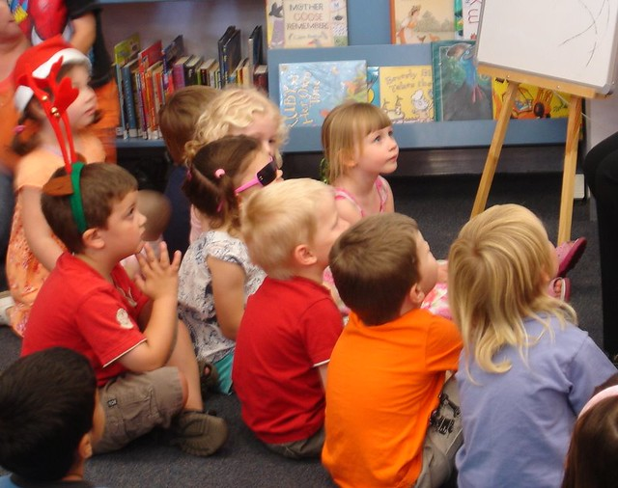
Lesson: Following the Group Plan
Skill # Standard SEL4: The child will demonstrate impulse control and stress management.
TELL:
We follow the group plan at school.
The group plan for story time is:
We use whole body listening when the teacher is reading.

Slide 6
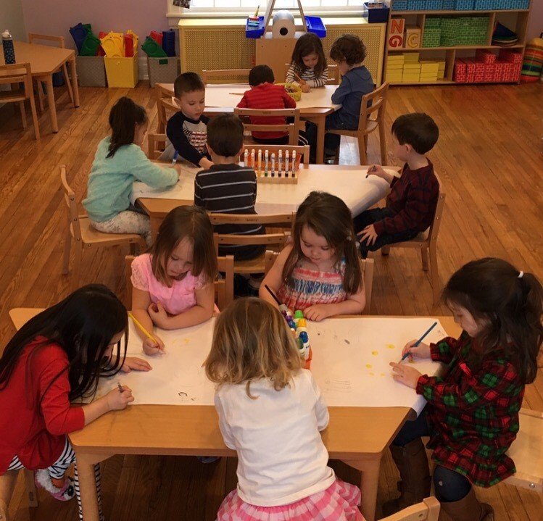
Lesson: Following the Group Plan
Skill # Standard SEL4: The child will demonstrate impulse control and stress management.
TELL:
We follow the group plan at school.
The group plan for center time is:
We sit at our tables and focus on our work.

Slide 7
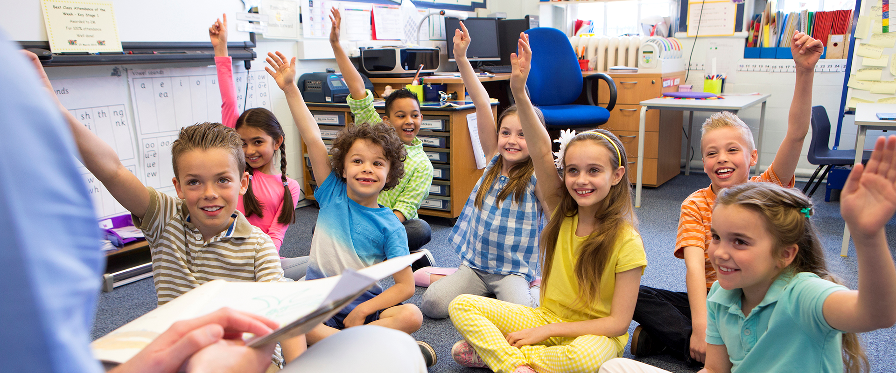
Lesson: Following the Group Plan
Skill # Standard SEL4: The child will demonstrate impulse control and stress management.
TELL:
We follow the group plan at school.
The group plan for getting the teachers attention is:
Raising your hand and waiting to be called on.

Slide 8
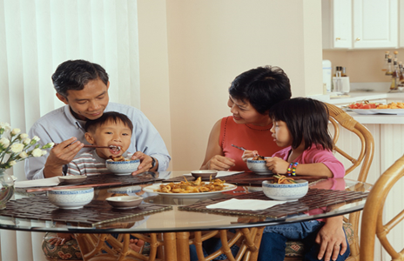
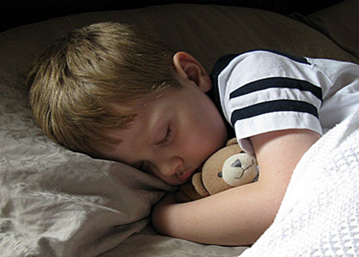
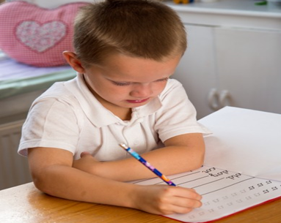
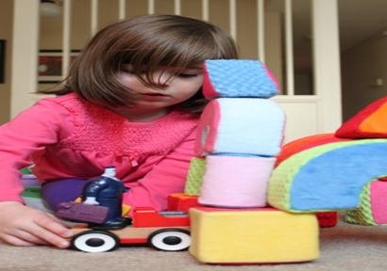
Lesson: Following the Group Plan
Skill # Standard SEL4: The child will demonstrate impulse control and stress management.
TELL:
There is always a group plan! Even at home.
The group plan at home is to do what you are expected to do and what is expected of your family at the time.
Meal time | Bed time
Work time | Play time

Slide 9

Lesson: Following the Group Plan
Skill # Standard SEL4: The child will demonstrate impulse control and stress management.
ASK:
Why is it important to follow the group plan at home and at school?

Slide 10
Lesson: Following the Group Plan
Skill # Standard SEL4: The child will demonstrate impulse control and stress management.
ASK:
Why is it important to follow the group plan at home and at school?
It is important because when we follow the group plan it:
Let’s everyone know we are working together.
It lets others know that you care about them and their feelings.
It lets the teacher know that you can follow the rules and you know what is expected.
It lets your family know that you can follow the rules at home and do what is expected.

Slide 11






Lesson: Following the Group Plan
Skill # Standard SEL4: The child will demonstrate impulse control and stress management.
ASK:
How does it make you feel when everyone is following the group plan?
What about when others are NOT following the group plan?

Slide 12
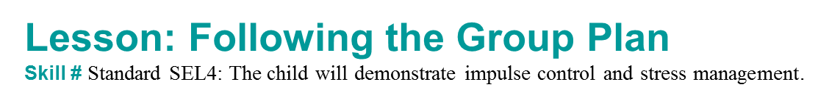

SHOW
In order to follow the group plan, what steps do we need to take?
Listen to the teacher or family member.
Look around the room if you are unsure. What is everyone else doing?
Choose to make the right choice. Am I following the group plan?

Slide 13

DO
Let’s Practice!
Listen to the situation and see show your family how you can follow the group plan.
Situation:
Your mother or father says it is time to turn off the TV and wash your hands for dinner.

Slide 14
DO
Let’s Practice!
Listen to the situation and see show your family how you can follow the group plan.
Situation:
You are sitting at the table with your family waiting for your dinner.

Slide 15
DO
Let’s Practice!
Listen to the situation and see show your family how you can follow the group plan.
Situation:
You were asked to clean up your toys before you have your lunch.

Slide 16
DO
Let’s Practice!
Listen to the situation and see show your family how you can follow the group plan.
Situation:
You are waiting for you turn in bathroom so you can brush your teeth before bed.

Slide 17


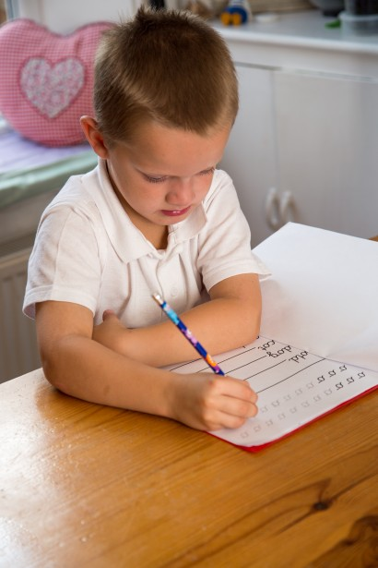

Practice.
This week, see if you can practice following the group plan at home in all of these areas.
Meal time | Bed time
Work time | Play time

